Slide 1
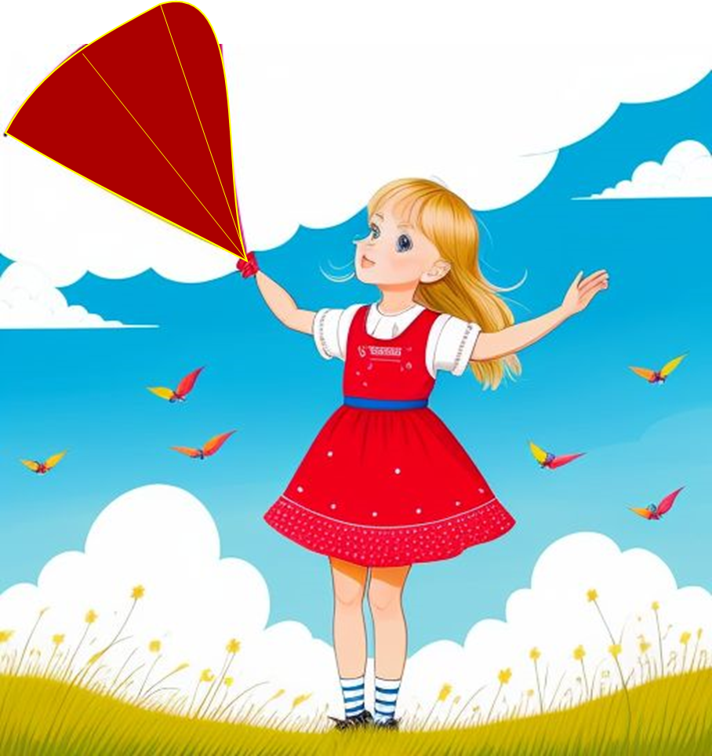
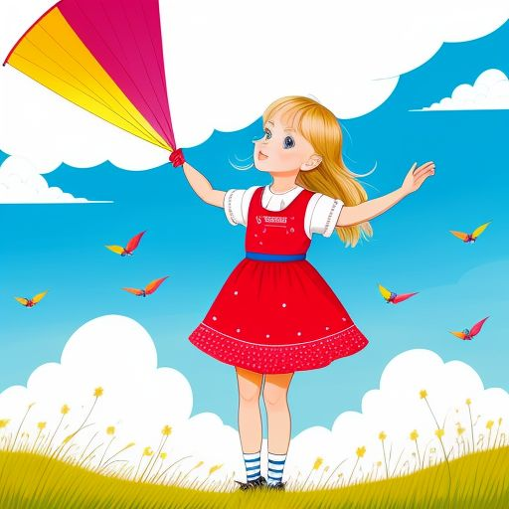

Today’s story is Emma and the Lost Kite. Let’s begin!
Emma and the Lost Kite

Slide 2

Emma is a little girl. She is eight years old. She loves to fly her red kite. One windy day, Emma flies her kite in the backyard.

Slide 3
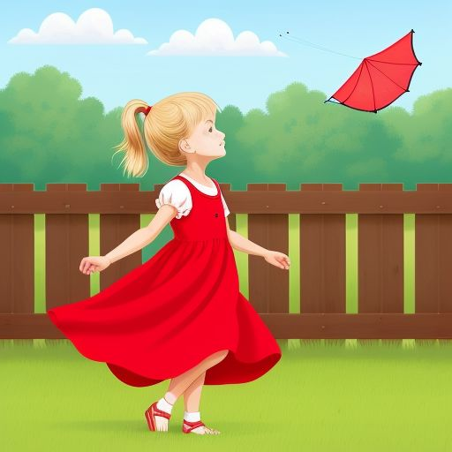
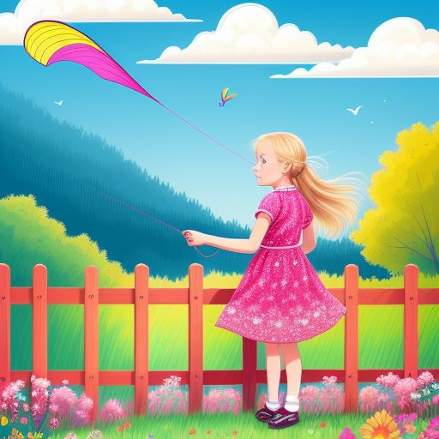
The wind is strong. Emma holds the string tightly. But the wind pulls the kite. The string slips! The kite flies away.

Slide 4
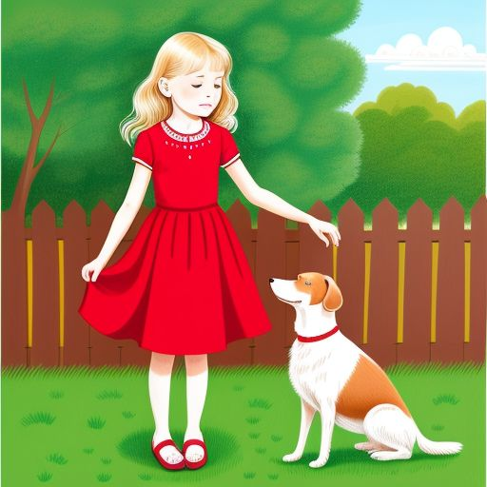

Emma looks up. She cannot see her kite. She feels sad. Her dog, Max, runs to her. Emma says, ‘Max, my kite is gone!

Slide 5
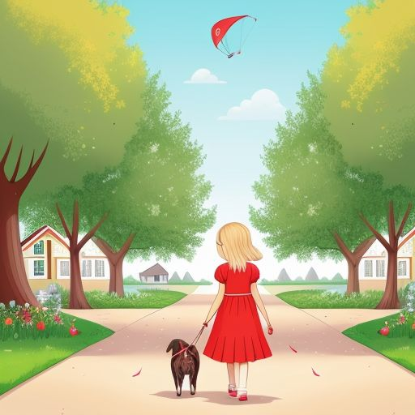

Emma and Max look for the kite. They walk down the street. Emma says, ‘Where is my kite? Let’s find it!

Slide 6
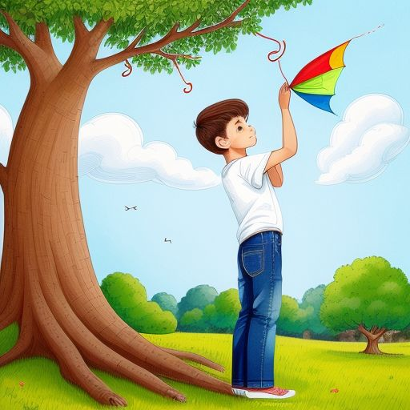
Emma sees a boy. His name is Ben. Ben says, ‘Is that your kite?’ Emma looks up. The kite is in a tree!

Slide 7
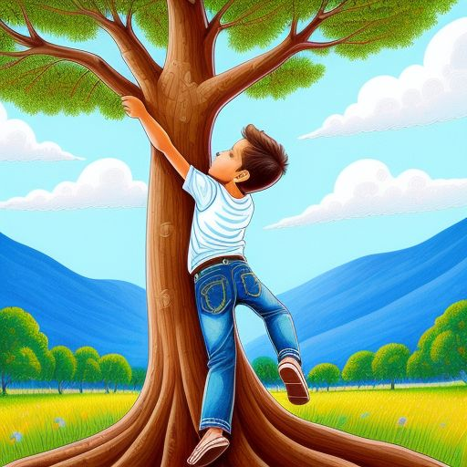
Ben climbs the tree. He reaches for the kite. Emma says, ‘Be careful, Ben!

Slide 8
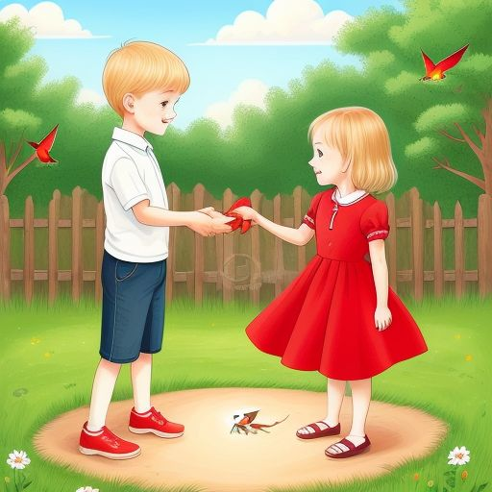
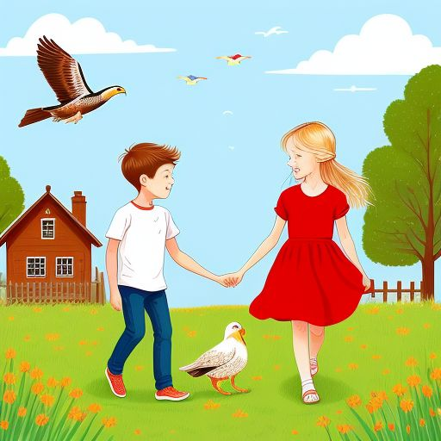
Ben gets the kite. He climbs down and gives it to Emma. Emma says, ‘Thank you, Ben!

Slide 9
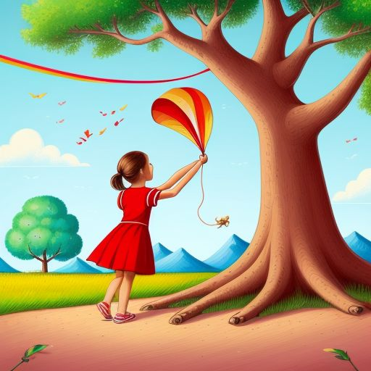
Emma flies her kite again. Ben and Max play in the park. Emma is happy. She says, ‘Flying a kite is fun!’

Slide 10
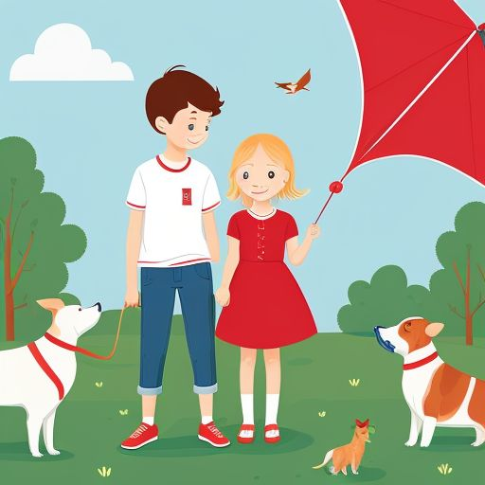
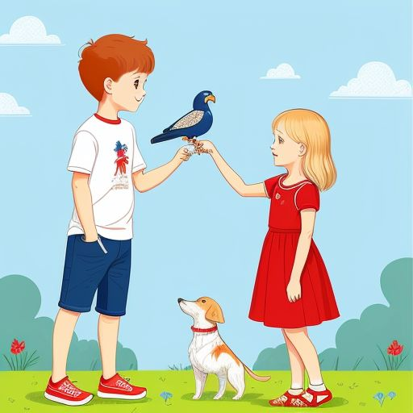
Emma lost her kite, but Ben helped her. Friends help each other. What did you learn from the story?

Slide 11
Where was the kite stuck?
What color was Emma’s kite?
Who helped Emma get the kite?

Slide 12
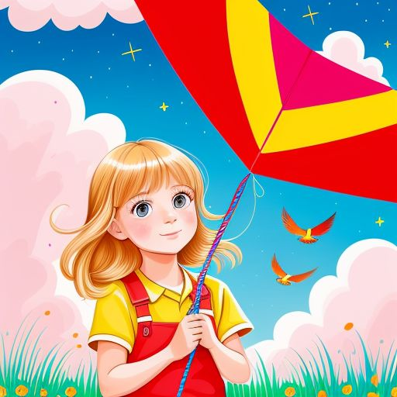
Thank you for listening! Watch more stories and practice English with us.

